Slide 1




NEXT GEN EMPLOYABILITY PROGRAM
Creating a future-ready workforce
Team Members
College Name
Student Name : SNOWVITA B
Student ID : au311121104055
Loyola ICAM College of Engineering and Technology (LICET)

Slide 2

CAPSTONE PROJECT SHOWCASE
Project Title
MUSIC WEB APPLICATION USING DJANGO FRAMEWORK
Abstract | Problem Statement | Project Overview | Proposed Solution | Technology Used | Modelling & Results | Conclusion

Slide 3
Abstract
Embark on a journey with us as we delve into the intricate process of constructing a sophisticated music web application powered by the Django framework. Throughout this presentation, we'll immerse ourselves in the depth of Django's capabilities, unraveling its diverse features to craft a dynamic platform tailored for music enthusiasts.
From user authentication to database management, search and discovery functionalities, seamless streaming experiences, playlist curation tools, and responsive design implementation, every aspect of our application design will be meticulously explored.
Join me as I navigate through the complexities of development, addressing challenges, and uncovering innovative solutions to create an immersive and engaging online music experience.
Source :

Slide 4
Problem Statement
In response to the evolving landscape of digital music consumption, there arises a pressing need to develop a sophisticated music web application leveraging the Django framework. This endeavor requires addressing multifaceted challenges, encompassing user authentication, database management, seamless music streaming, intuitive playlist organization, and responsive interface design.
The aim is to engineer a comprehensive platform that not only caters to users' diverse music preferences but also ensures optimal performance and scalability. This undertaking seeks to redefine the standards of online music platforms, presenting an opportunity to innovate and elevate the music streaming experience for users worldwide.
Source :

Slide 5
Project Overview
Objective: Develop a user-friendly music web application using Django.
Key Features:
User Authentication
Database Management
Music Discovery
Streaming Capabilities
Playlist Management
Responsive Design
Project Goals:
Set a new standard in online music streaming.
Prioritize user experience and security.
Ensure scalability and performance optimization.
Source :

Slide 6
Proposed Solution
Utilize Django Framework:
Leverage Django's MVC architecture for structured and scalable development.
Utilize Django's ORM for efficient database management and data retrieval.
Implement Key Features:
User Authentication: Ensure secure user login and account management.
Music Catalog Management: Organize and manage a comprehensive music database.
Streaming Capabilities: Implement seamless music playback functionality.
Responsive Design:
Design user interfaces that adapt to different screen sizes and devices.
Prioritize user experience by ensuring smooth navigation and intuitive controls.
Integration:
Integrate with external APIs for expanded music catalog and additional features.
Utilize third-party services for analytics, social sharing, and payment processing.
Source :

Slide 7
Personalization:
Implement recommendation algorithms to suggest music based on user preferences.
Offer personalized playlists and curated content to enhance user engagement.
Scalability:
Design architecture that can handle increased user traffic and data volume.
Implement load balancing and caching mechanisms for improved performance.
Continuous Improvement:
Plan for regular updates and feature enhancements based on user feedback.
Conduct testing and quality assurance to ensure a seamless user experience.
Community Engagement:
Encourage user interaction through forums, comments, and user-generated content.
Foster a sense of community through shared playlists and collaborative features.
Security Measures:
Implement encryption protocols to protect user data and ensure privacy.
Utilize best practices for securing user authentication and authorization processes.
Source :

Slide 8


Technology Used
Front-end
Back-end
Source :

Slide 9
Modelling & Results
Developed a Structured Database Schema:
Leveraged Django's ORM to design an organized and efficient database schema.
Ensured seamless data handling and retrieval, optimizing performance.
Integrated a User Authentication System:
Implemented a secure user authentication system for protected user accounts.
Ensured data privacy and secure access management.
Designed User Interfaces for Seamless Navigation:
Crafted intuitive interfaces for effortless navigation and interaction.
Prioritized user satisfaction and engagement through user-friendly design.
Established Optimized Data Caching Techniques:
Implemented data caching methods to enhance streaming performance.
Provided smooth music playback experience with minimal buffering.
Ensured Compatibility and Responsiveness Across Devices:
Designed for compatibility across various devices and screen sizes.
Ensured a consistent user experience, leading to increased usage and positive feedback.
Source :

Slide 10
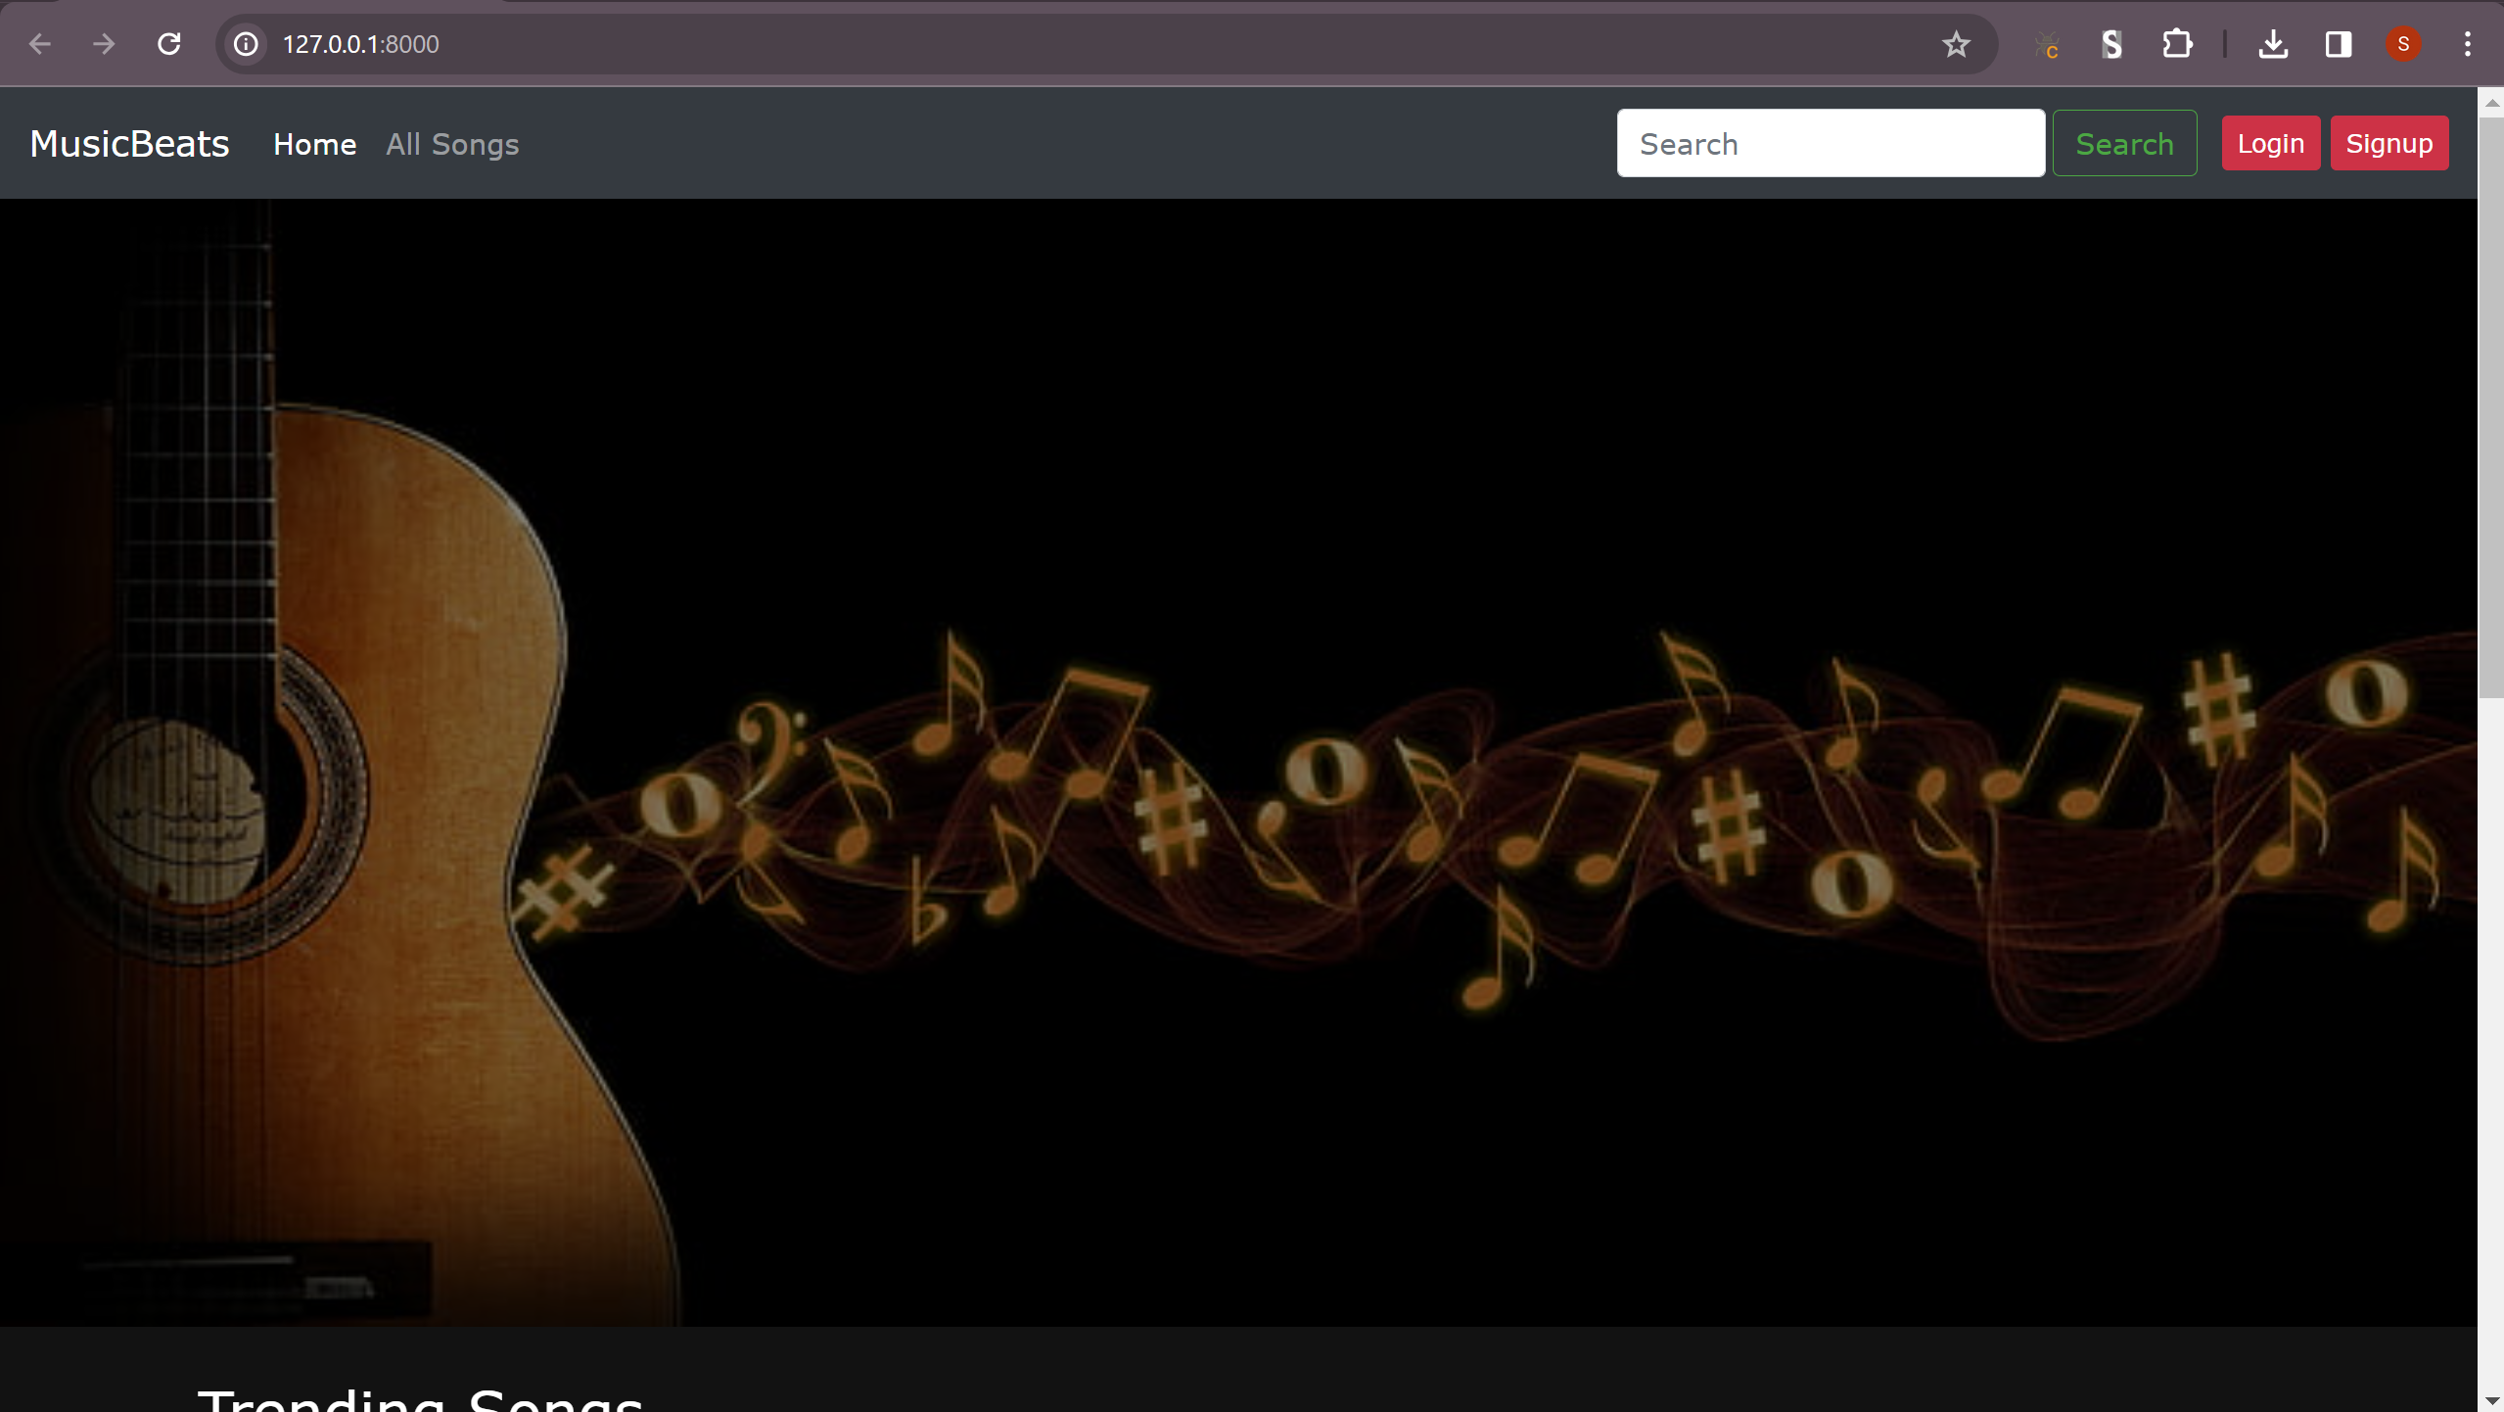
Home Page – Before Login/SignUp

Slide 11
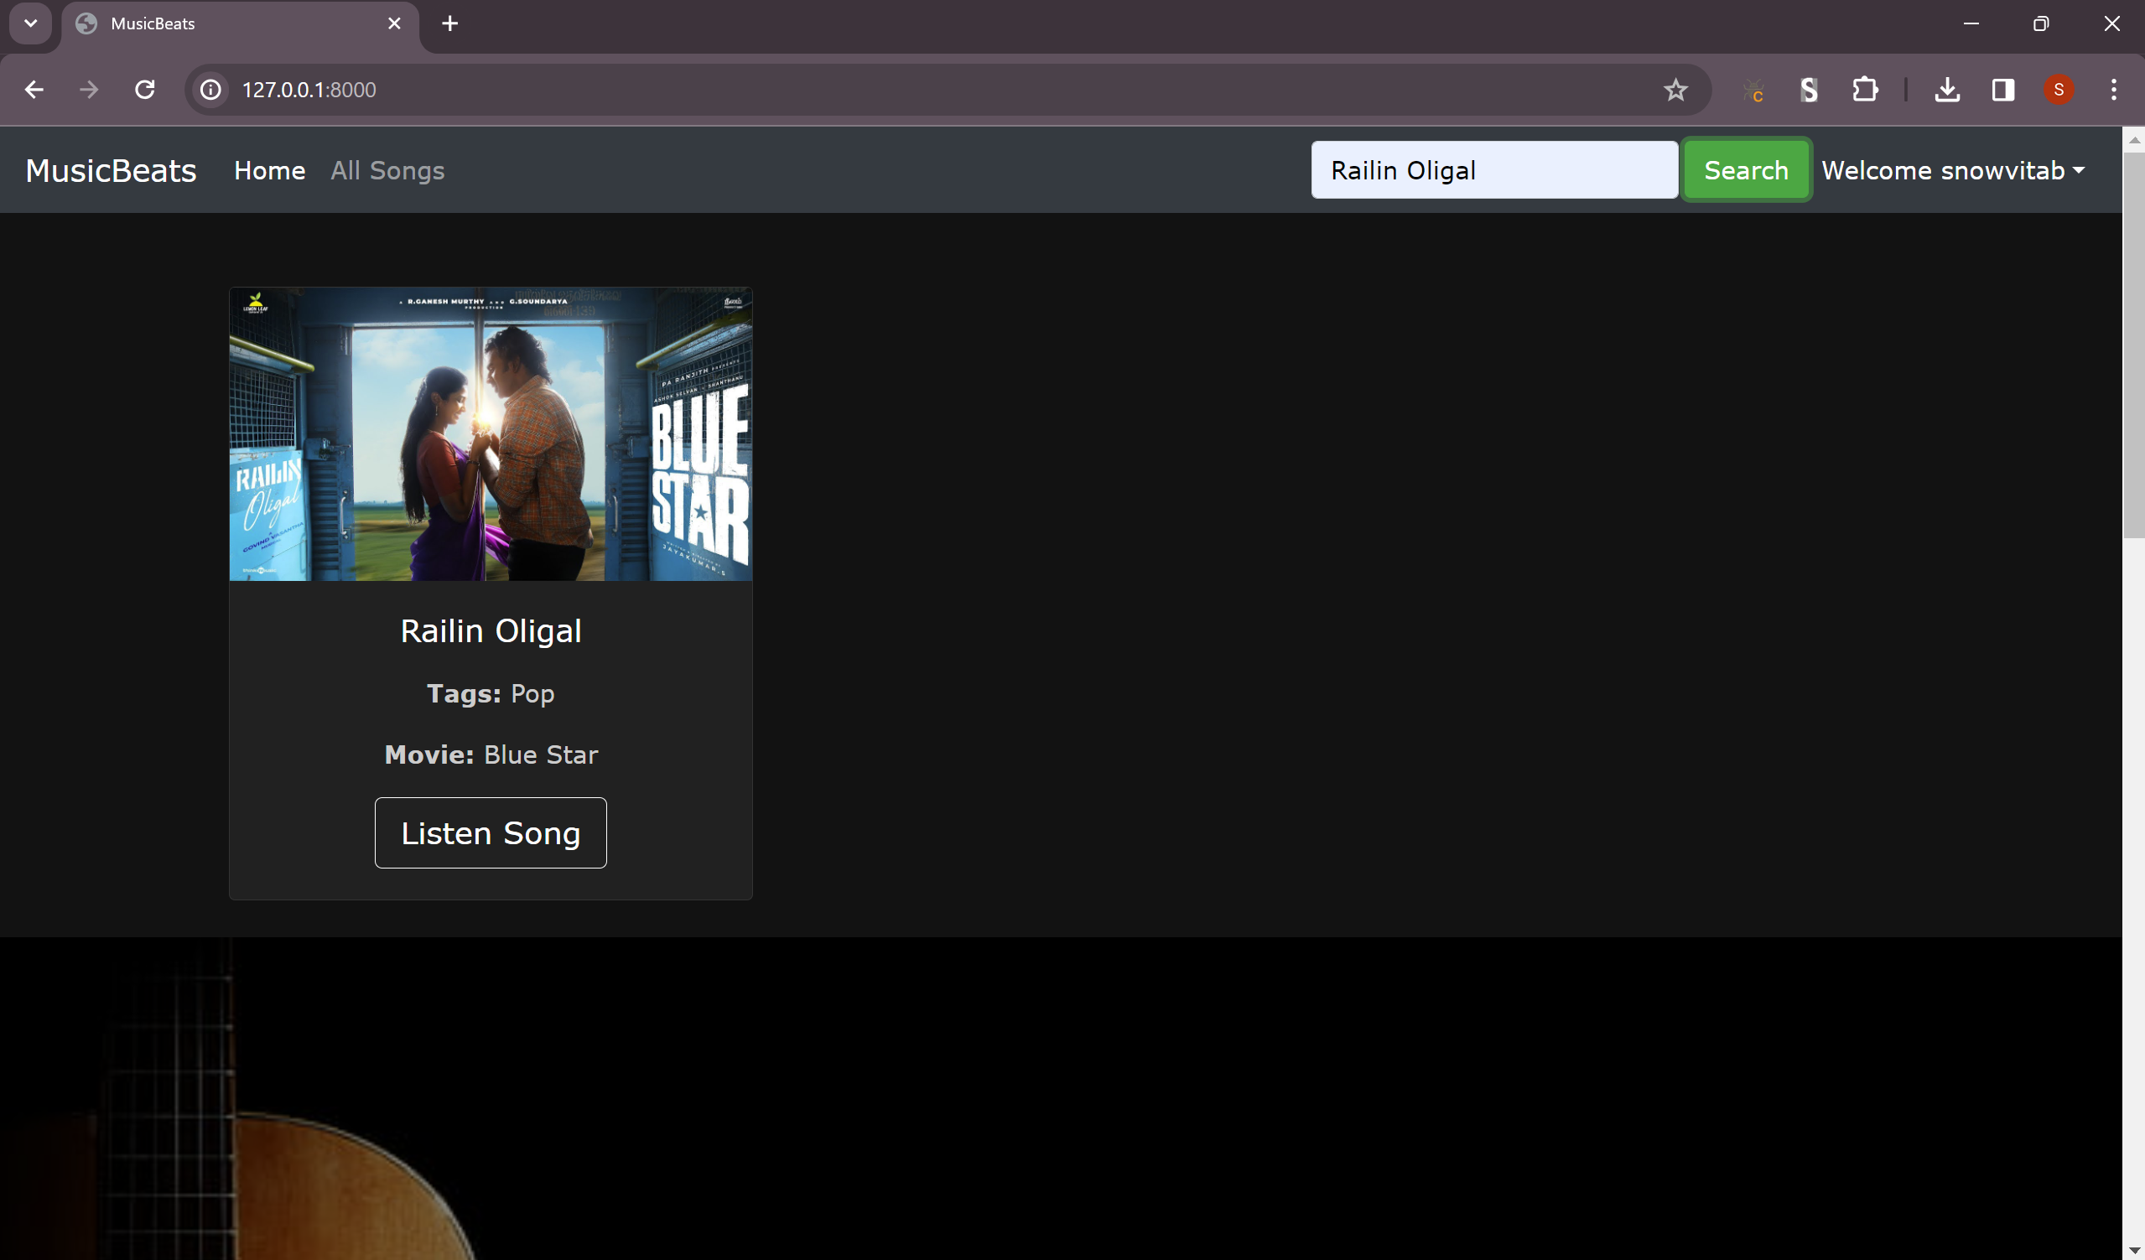
Search Functionality

Slide 12
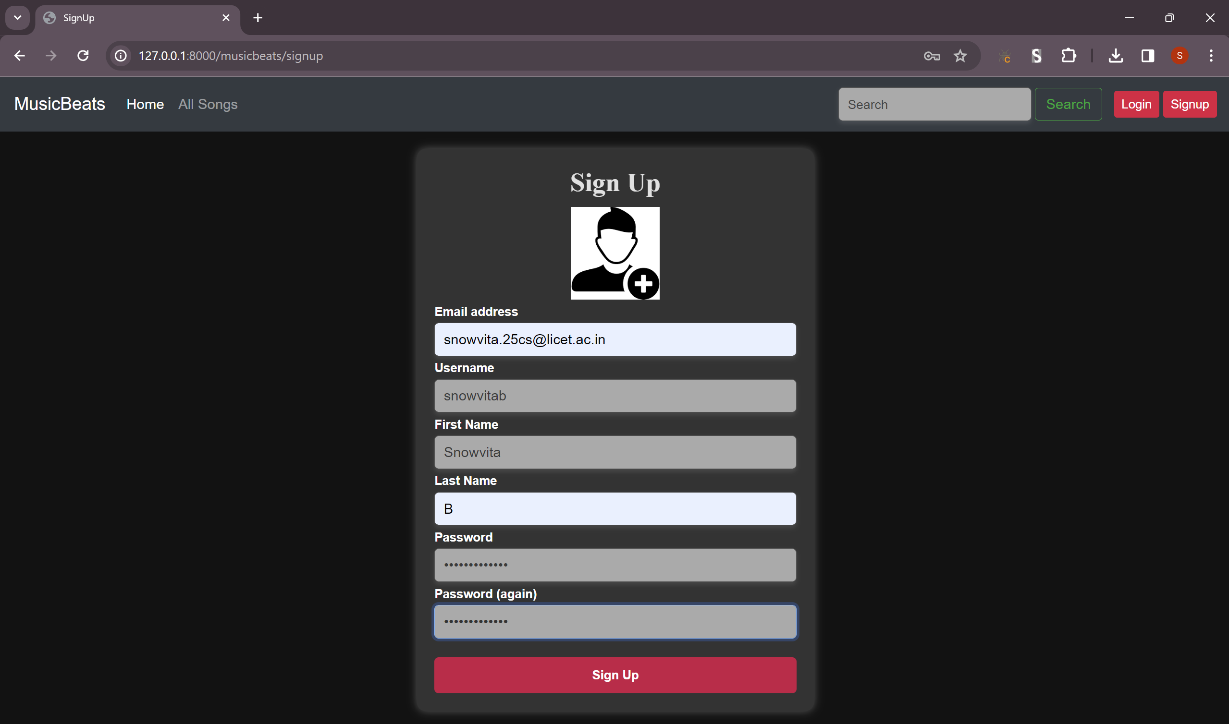
Sign Up Page

Slide 13
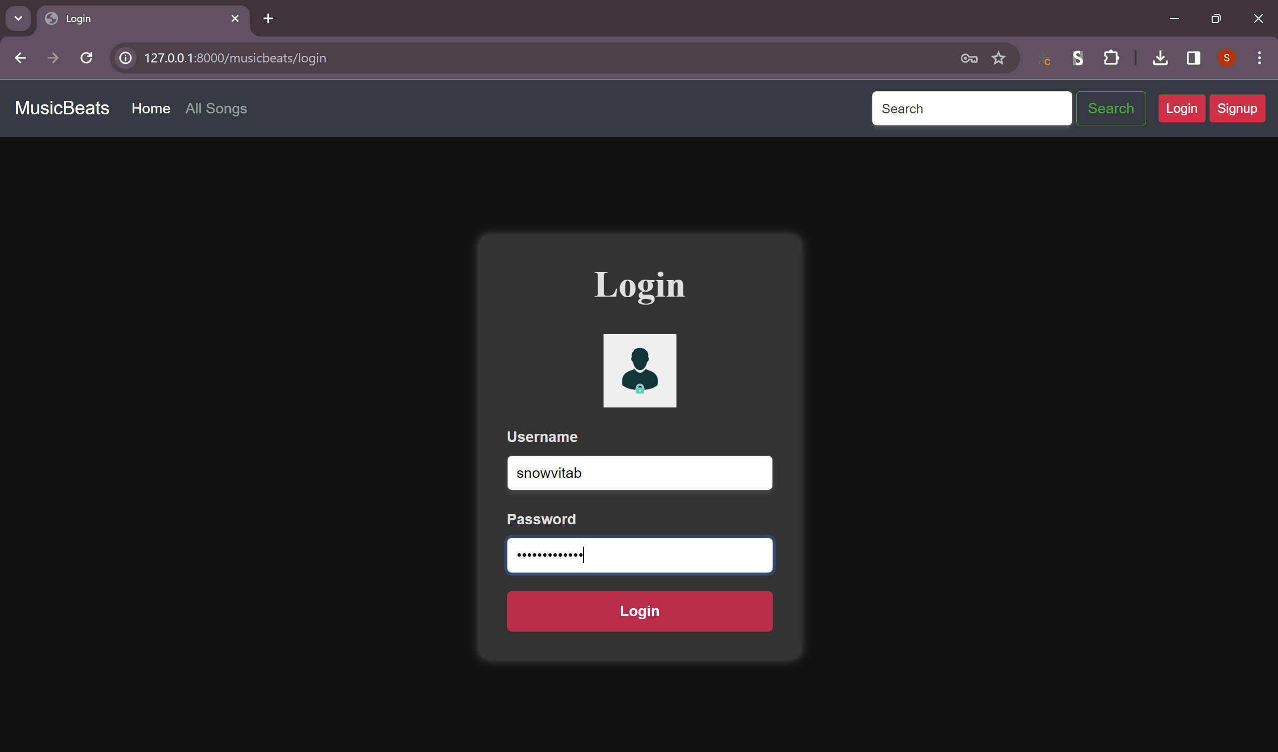
Login Page

Slide 14
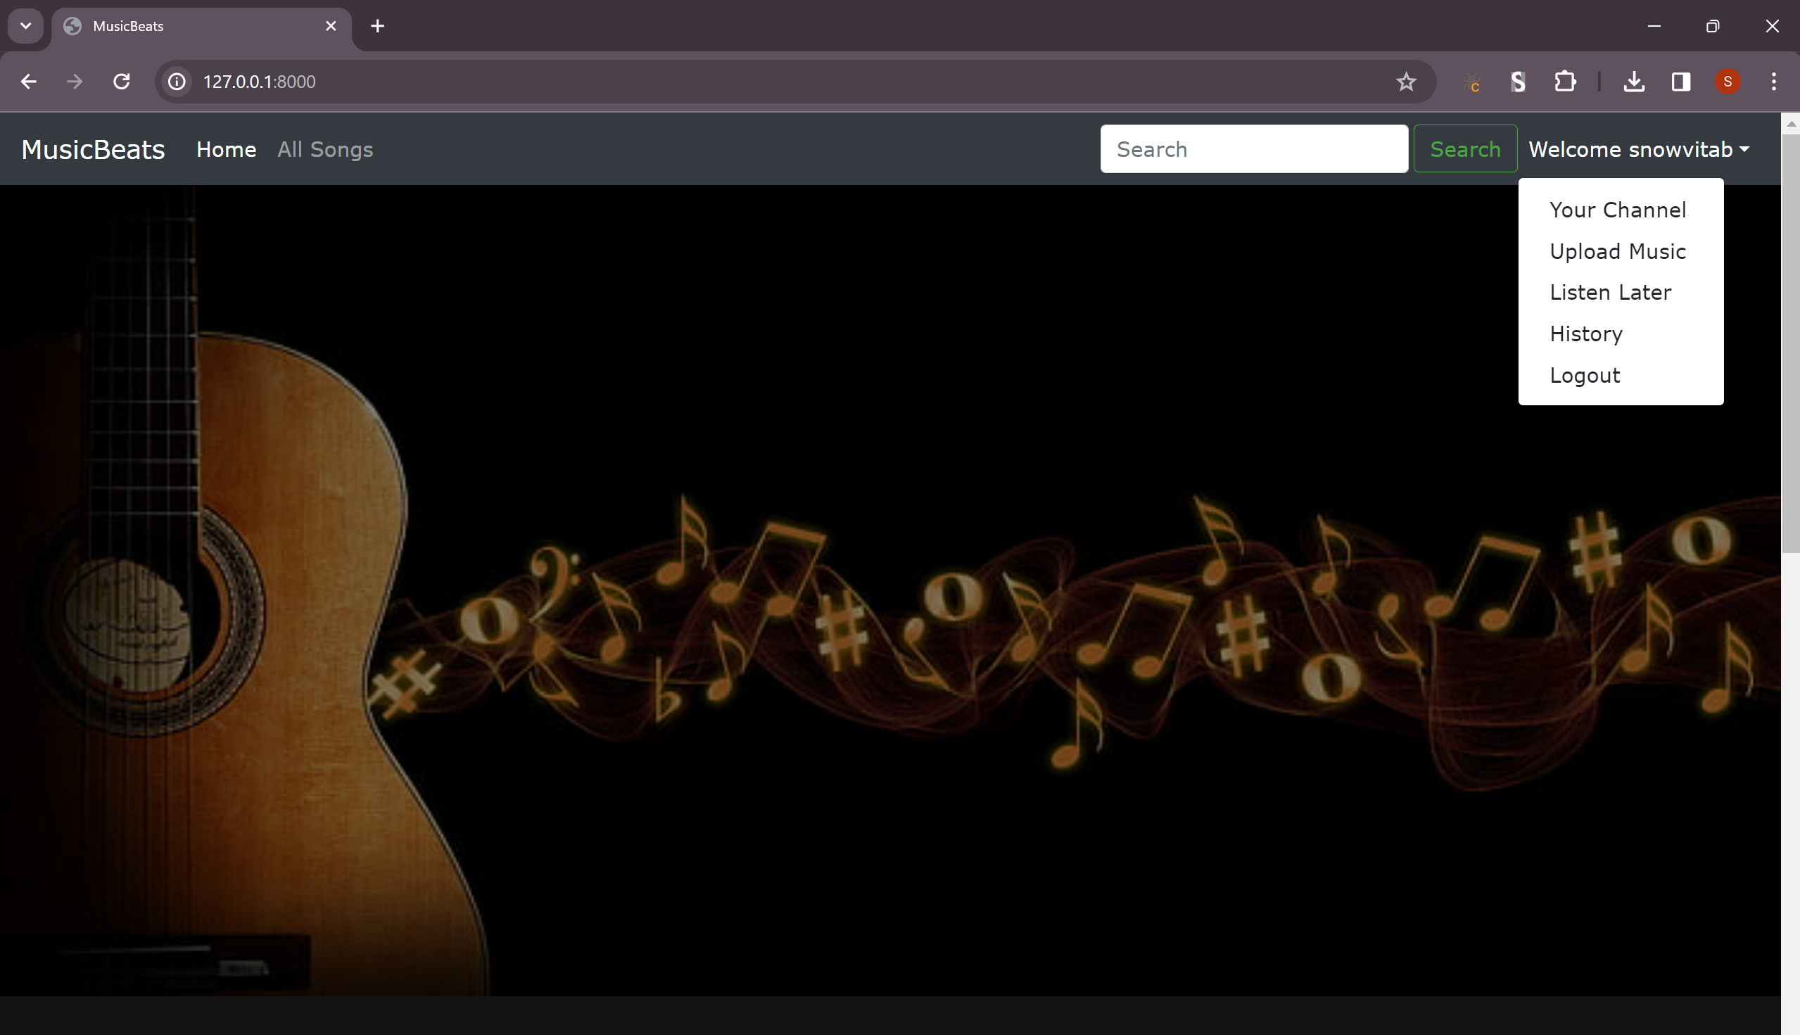
Home Page – After Login

Slide 15
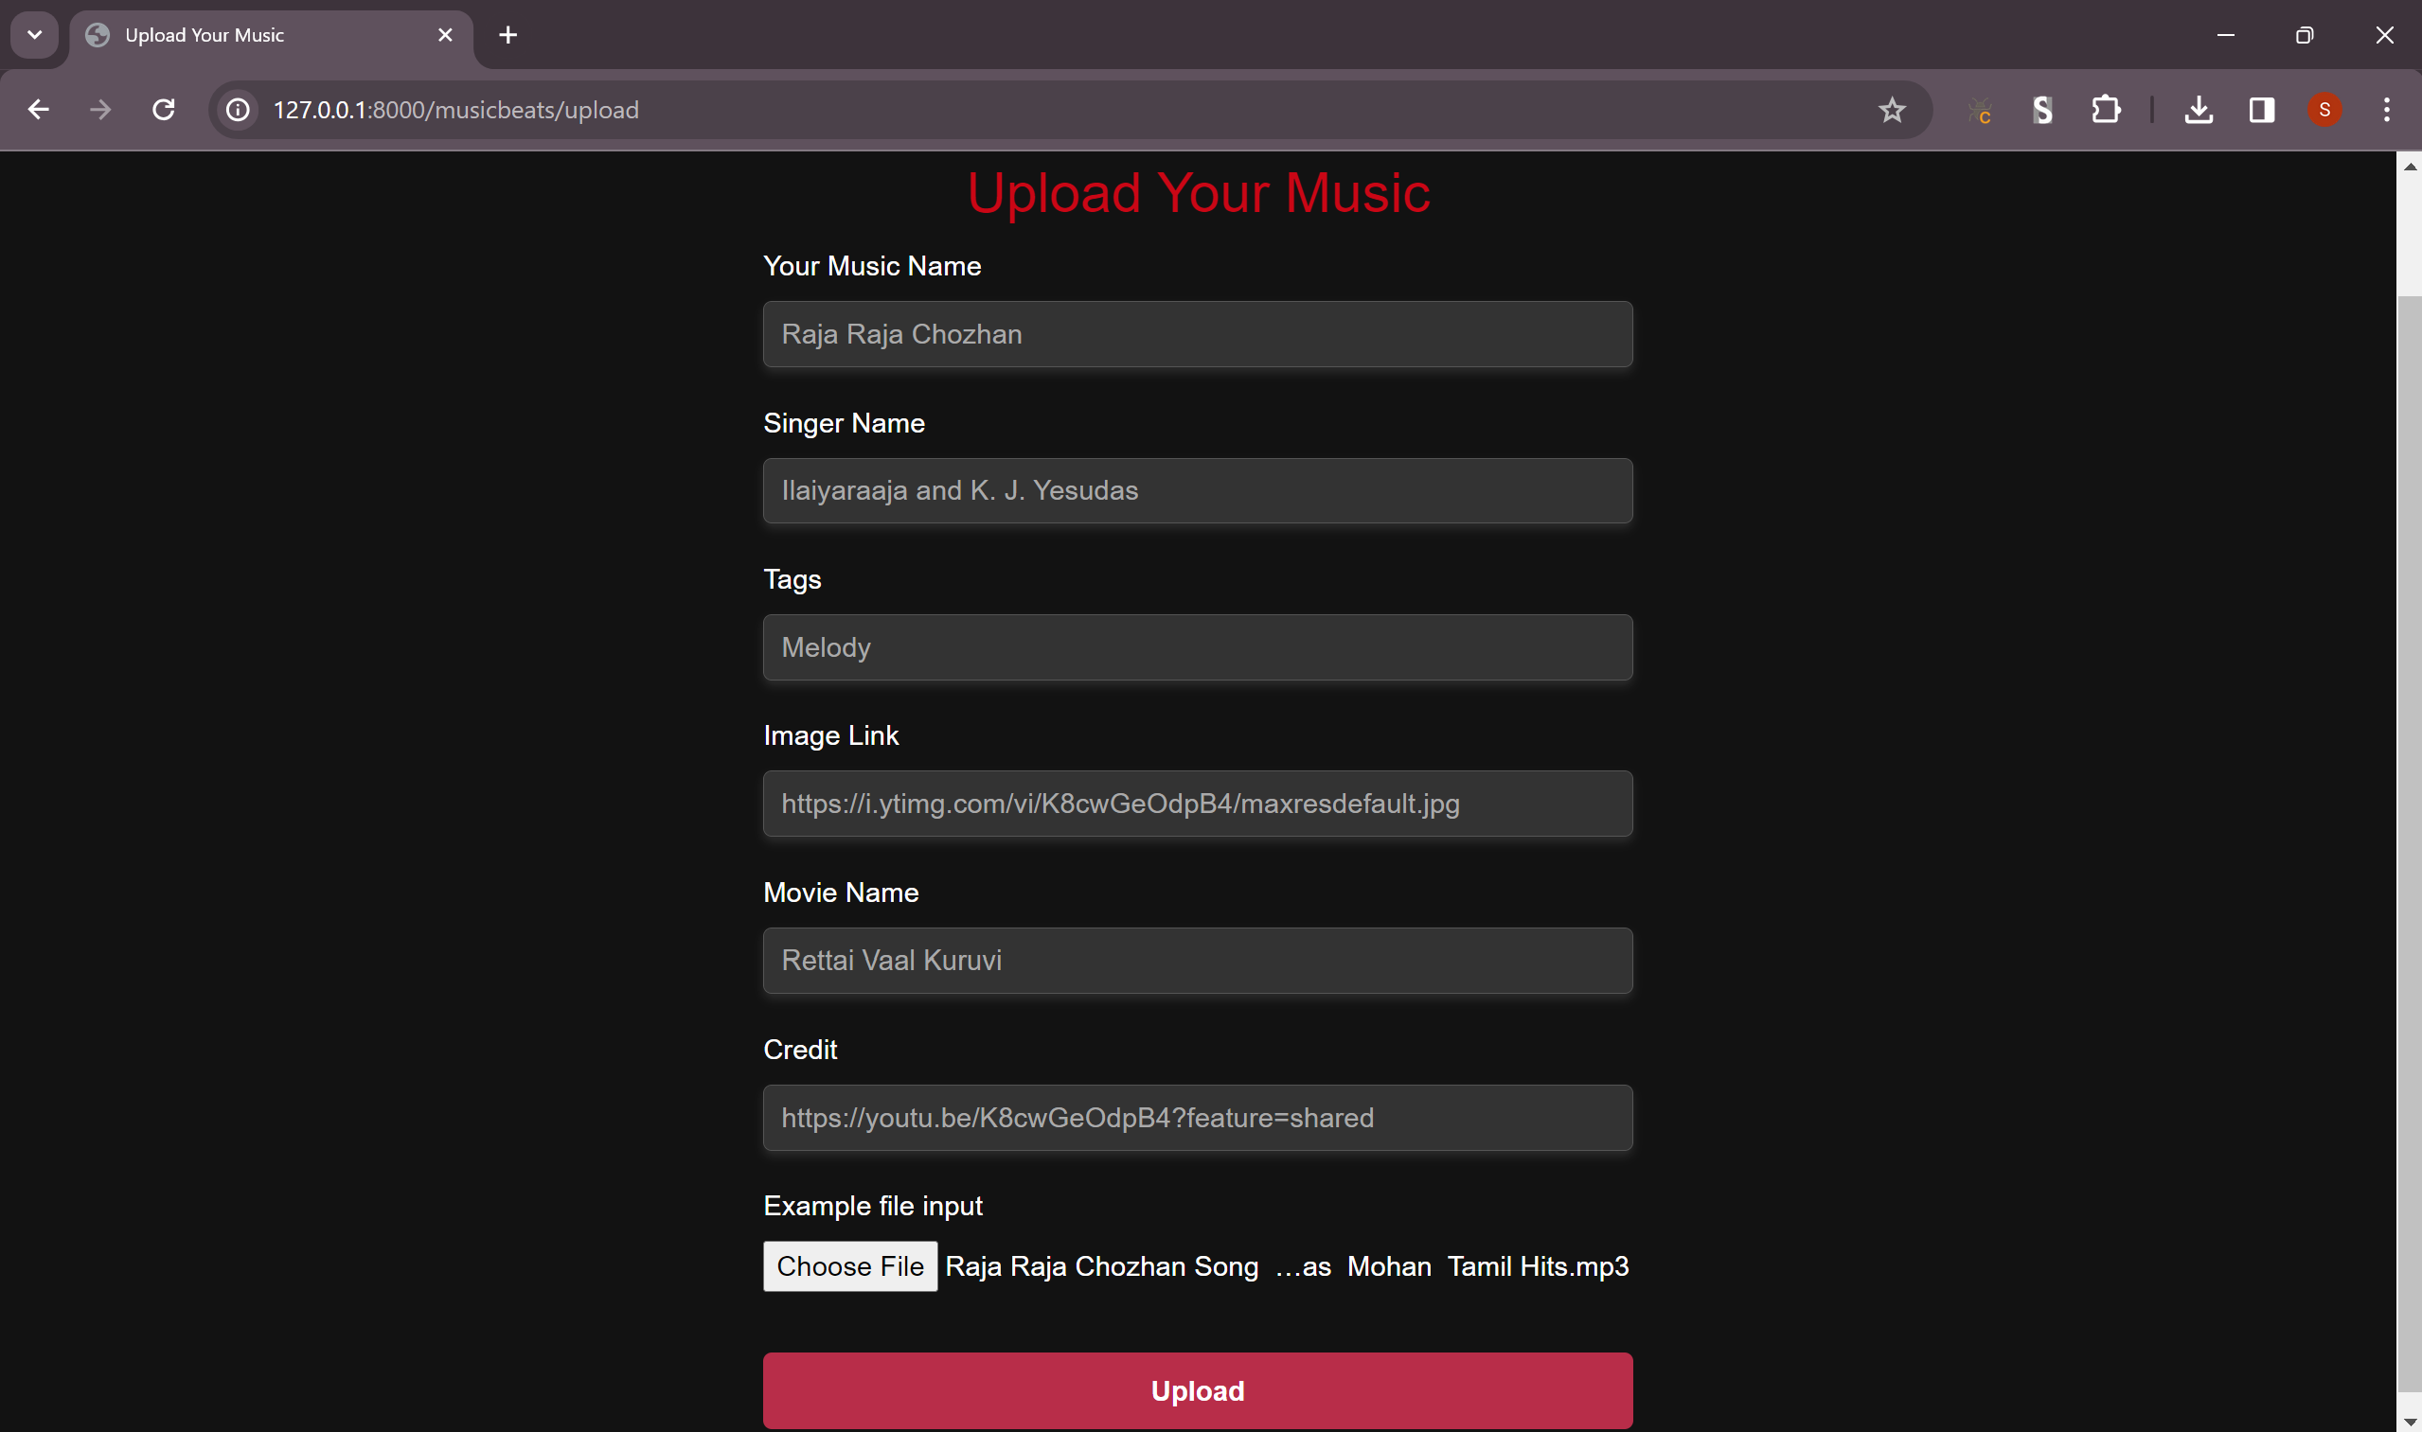
Upload Music Page

Slide 16
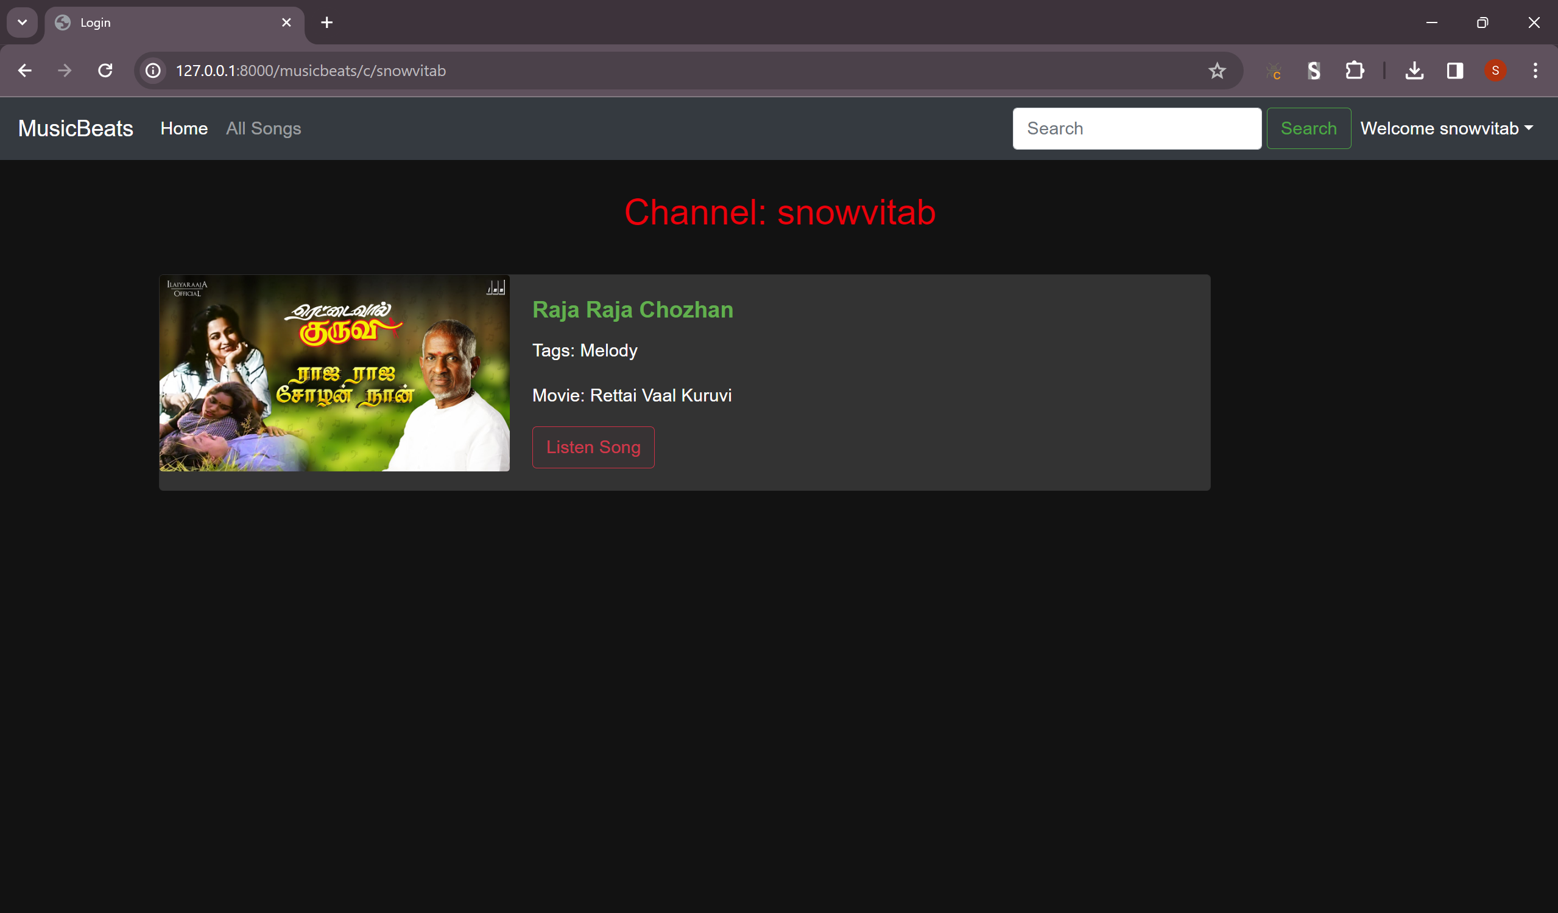
Channel Page

Slide 17
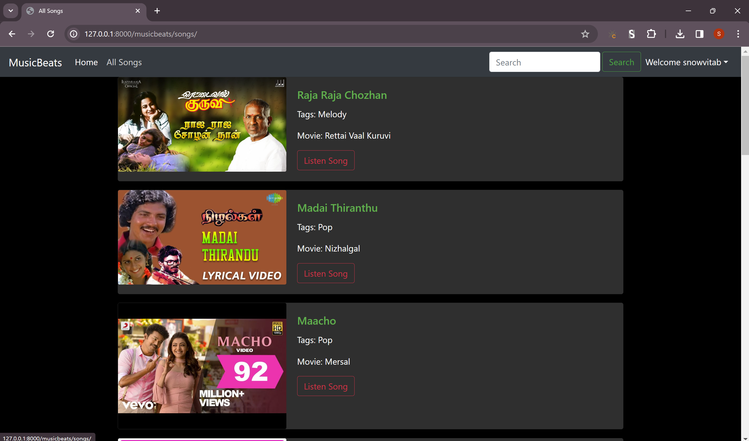
All Songs Page

Slide 18
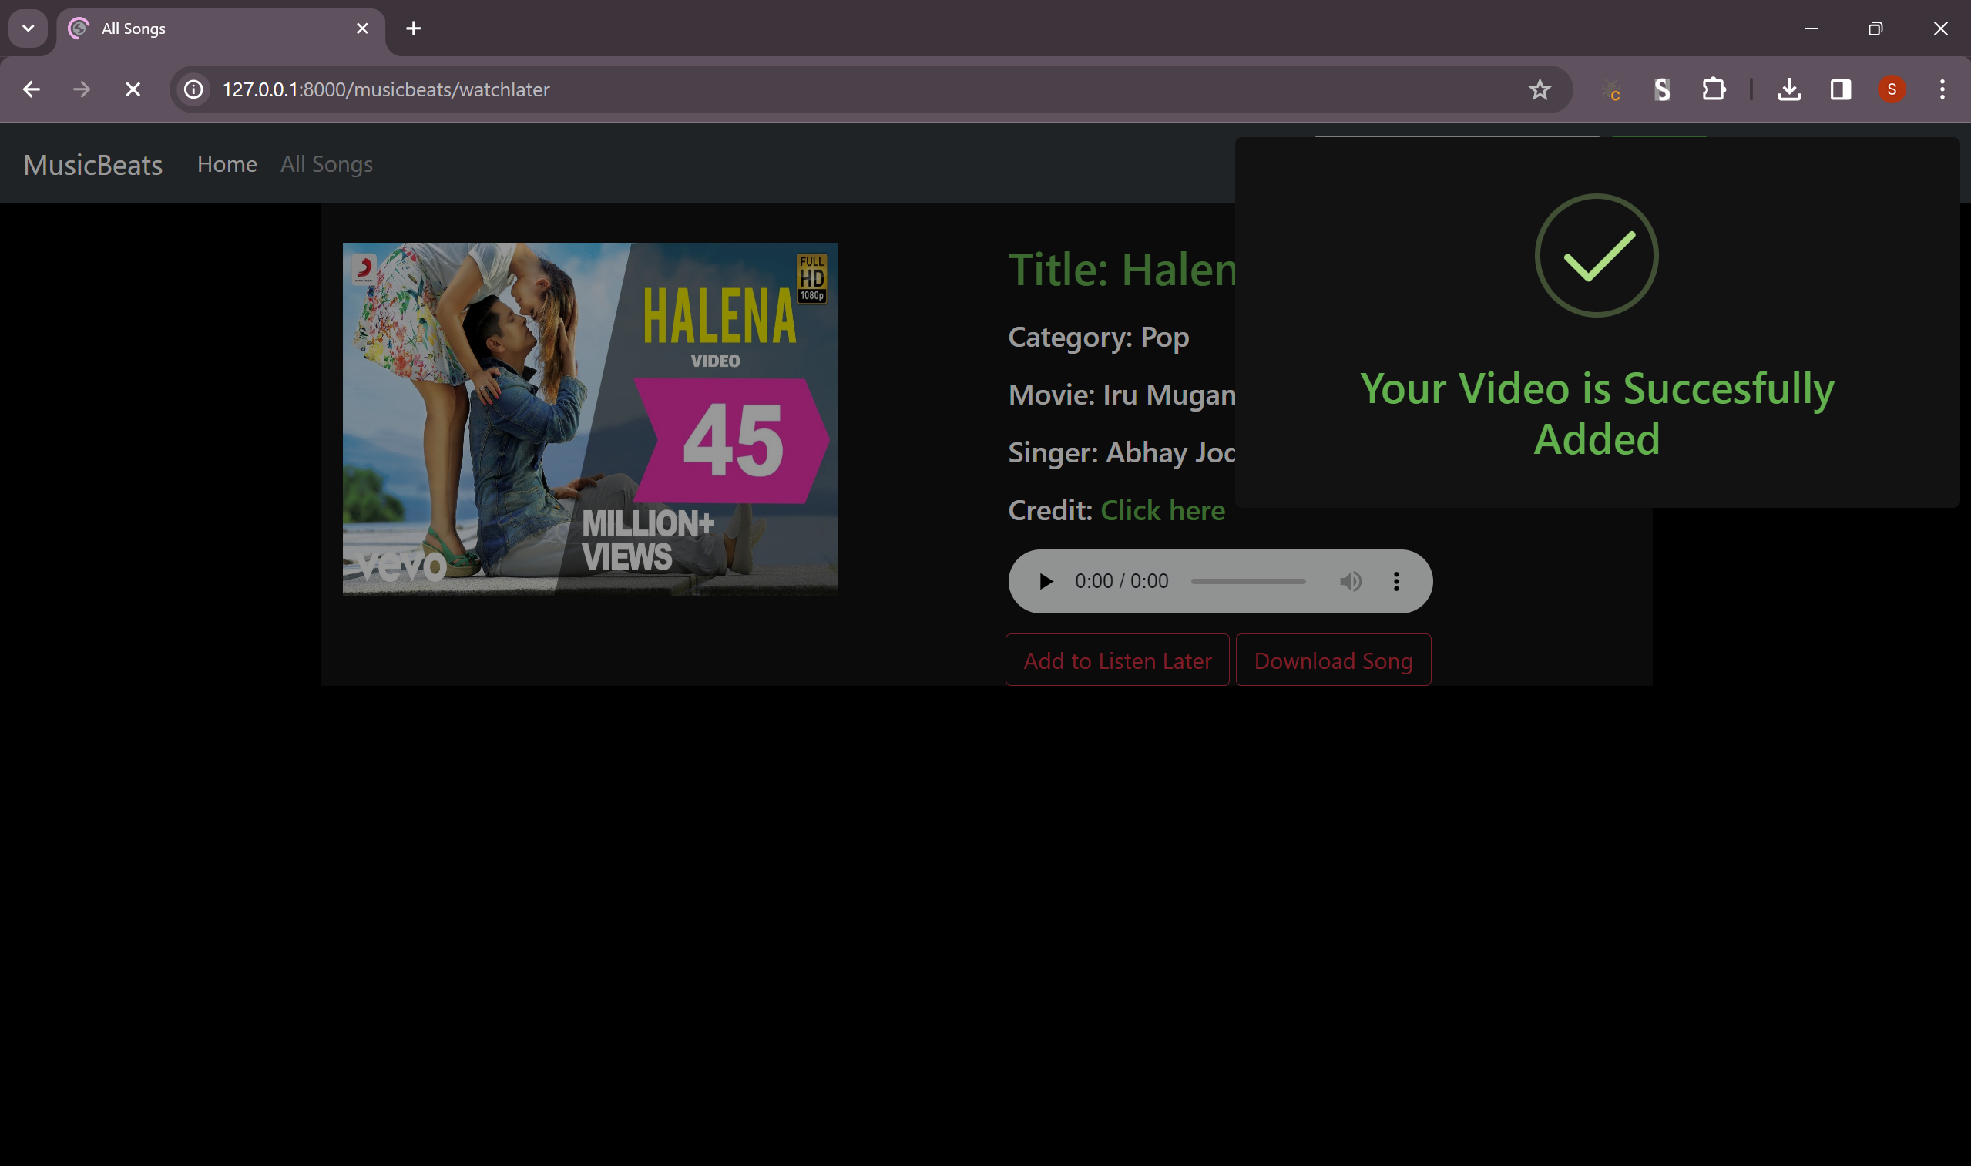
Add To Listen Later Functionality

Slide 19
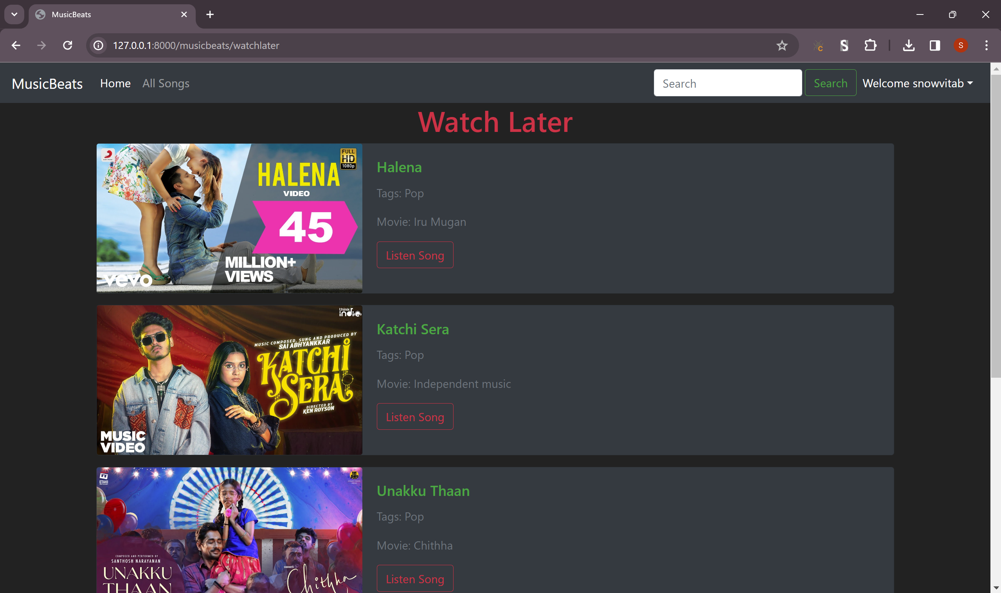
Watch Later Page

Slide 20
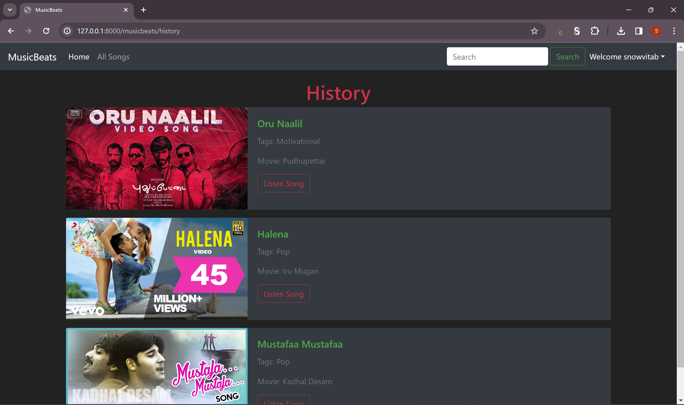
History Page

Slide 21
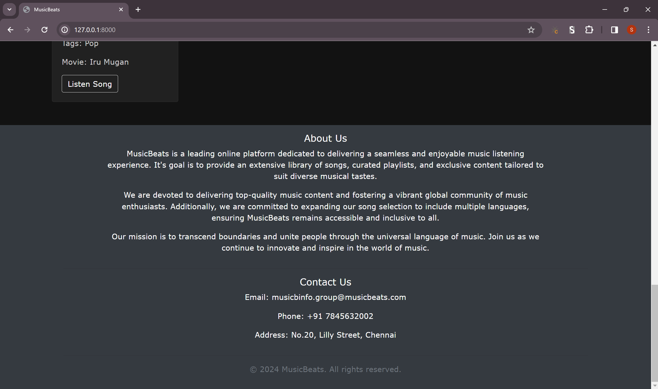
Home Page – About US Section

Slide 22
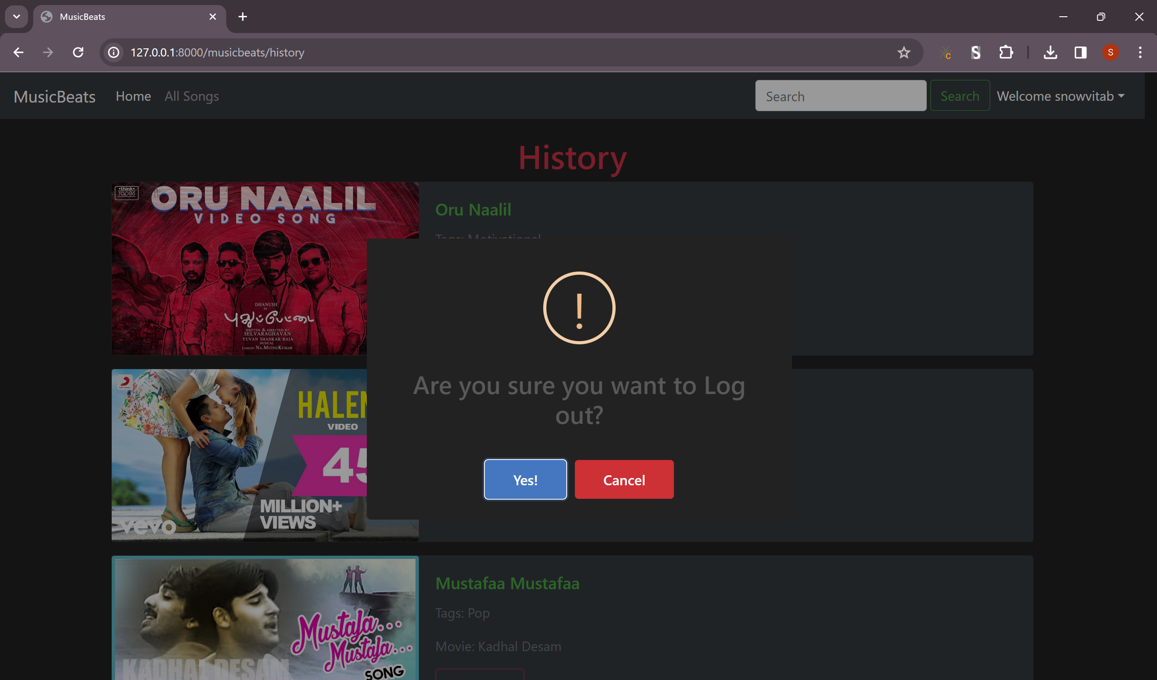
Logout Functionality

Slide 23
Future Enhancements:
Enhanced Social Integration: Allow users to seamlessly share their favorite music tracks and playlists on popular social media platforms. Implement social login options for simplified authentication and improved user engagement.
Smart Recommendations: Develop advanced recommendation algorithms leveraging machine learning to offer personalized music suggestions based on user preferences, listening habits, and contextual data. Introduce curated playlists tailored to specific moods, activities, or genres, providing users with a more immersive music discovery experience.
Real-time Collaboration: Enable users to collaboratively create and manage playlists with friends or within communities. Implement real-time synchronization to ensure seamless collaboration and instant updates across all users involved.
API Integration: Integrate with popular music APIs such as Spotify or Apple Music to expand the music catalog and access additional features. Utilize APIs for enhanced metadata retrieval, improved music streaming quality, and seamless synchronization across devices.
Advanced Analytics: Implement comprehensive analytics tools to gather valuable insights into user behavior, content preferences, and engagement patterns. Utilize data-driven insights to refine recommendation algorithms, optimize user experience, and drive business decisions.
Offline Mode Enhancement: Enhance offline mode functionality to allow users to download entire playlists or albums for offline listening. Implement smart caching mechanisms to optimize storage usage and ensure seamless transition between online and offline modes.

Slide 24
Conclusion
The development of a music web application using Django framework presents an exciting opportunity to create a dynamic and engaging platform for music enthusiasts.
Through the implementation of key features such as user authentication, database management, music discovery, streaming capabilities, playlist management, and responsive design, we have laid a solid foundation for a robust music streaming experience.
Future enhancements, including advanced social integration, personalized recommendations, real-time collaboration, API integration, advanced analytics, and offline mode enhancements, promise to further elevate the user experience and stay ahead of industry trends.
By leveraging Django's capabilities and continuously innovating, we are poised to deliver a music web application that not only meets but exceeds the expectations of our users, setting new standards in online music streaming platforms.
Source :

Slide 25
Thank You!
Notes:
Thank You !!

